Slide 1
Ask Your Cryptographer if Context-Committing AEAD Is Right for You
Mihir Bellare, John Chan, Paul Grubbs, Viet Tung Hoang, Sanketh Menda, Julia Len, Thomas Ristenpart, and Phillip Rogaway
Notes:
Thank you for the introduction.
I am so happy to be here. Today I'll be making a case for context committing AEAD.

Slide 2



Authenticated Encryption with Associated Data (AEAD)
Context:
Key K
Nonce N (e.g., random IV or counter)
Associated data A (e.g., network header)
Shared out of band.
K, N, A
K, N, A
C = AEAD.Enc(K,N,A,M)
Can observe and manipulate.
Sender
Recipient
Meddler-in-the-middle
Standardized
AES-GCM
ChaCha20/Poly1305
AES-GCM-SIV
Provably Secure
Confidentiality
Authenticity
Notes:
Our story starts with authenticated encryption with associated data also known as AEAD.
This is one of the most fundamental primitives. It is used everywhere from TLS to cloud storage to end-to-end encrypted messaging.
It enables a sender and a recipient with a shared context to exchange messages over an insecure channel.
Here, the context consists of a key, a nonce like a random IV or a counter, and an associated data like a network header. The key must be shared out-of-band, the nonce and the associated data can be shared out-of-band or shared with the ciphertext. This allows sending encrypted messages to the recipient with confidentiality and authenticity.
We have many schemes that achieve these goals including AES-GCM, ChaCha20/Poly1305, and AES-GCM-SIV. These schemes are standardized and widely deployed. If you are using encryption, chances are you are using one of these schemes.
Finally, these schemes have security proofs showing that they achieve confidentiality and authenticity in the presence of a meddler-in-the-middle like a network adversary who can observe and manipulate ciphertexts.

Slide 3
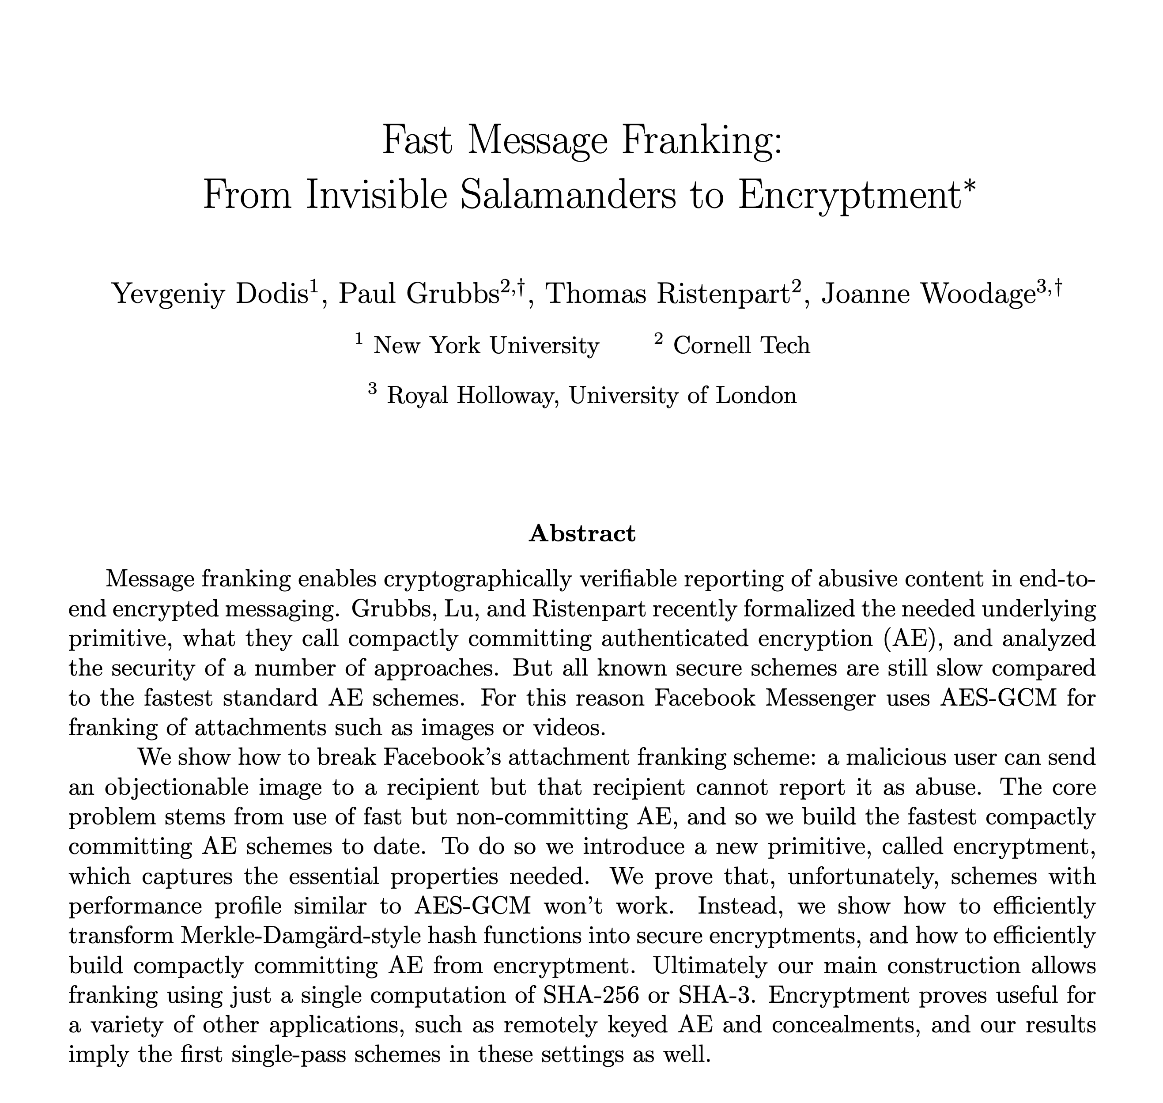
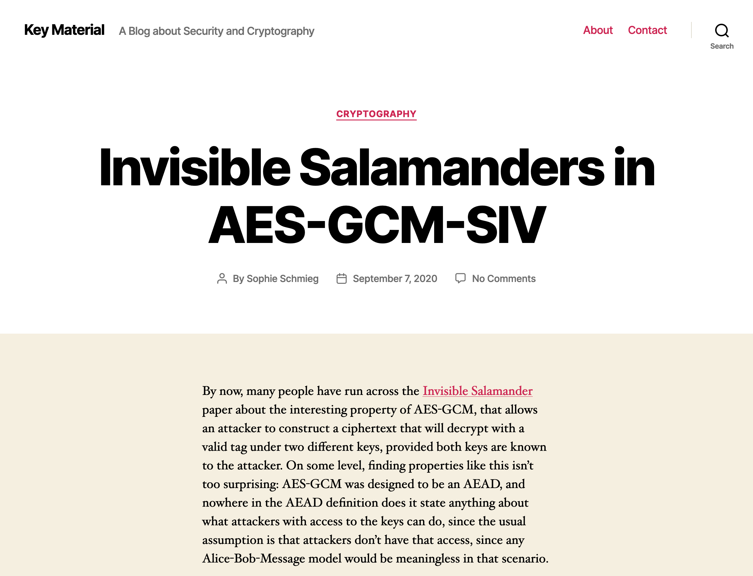
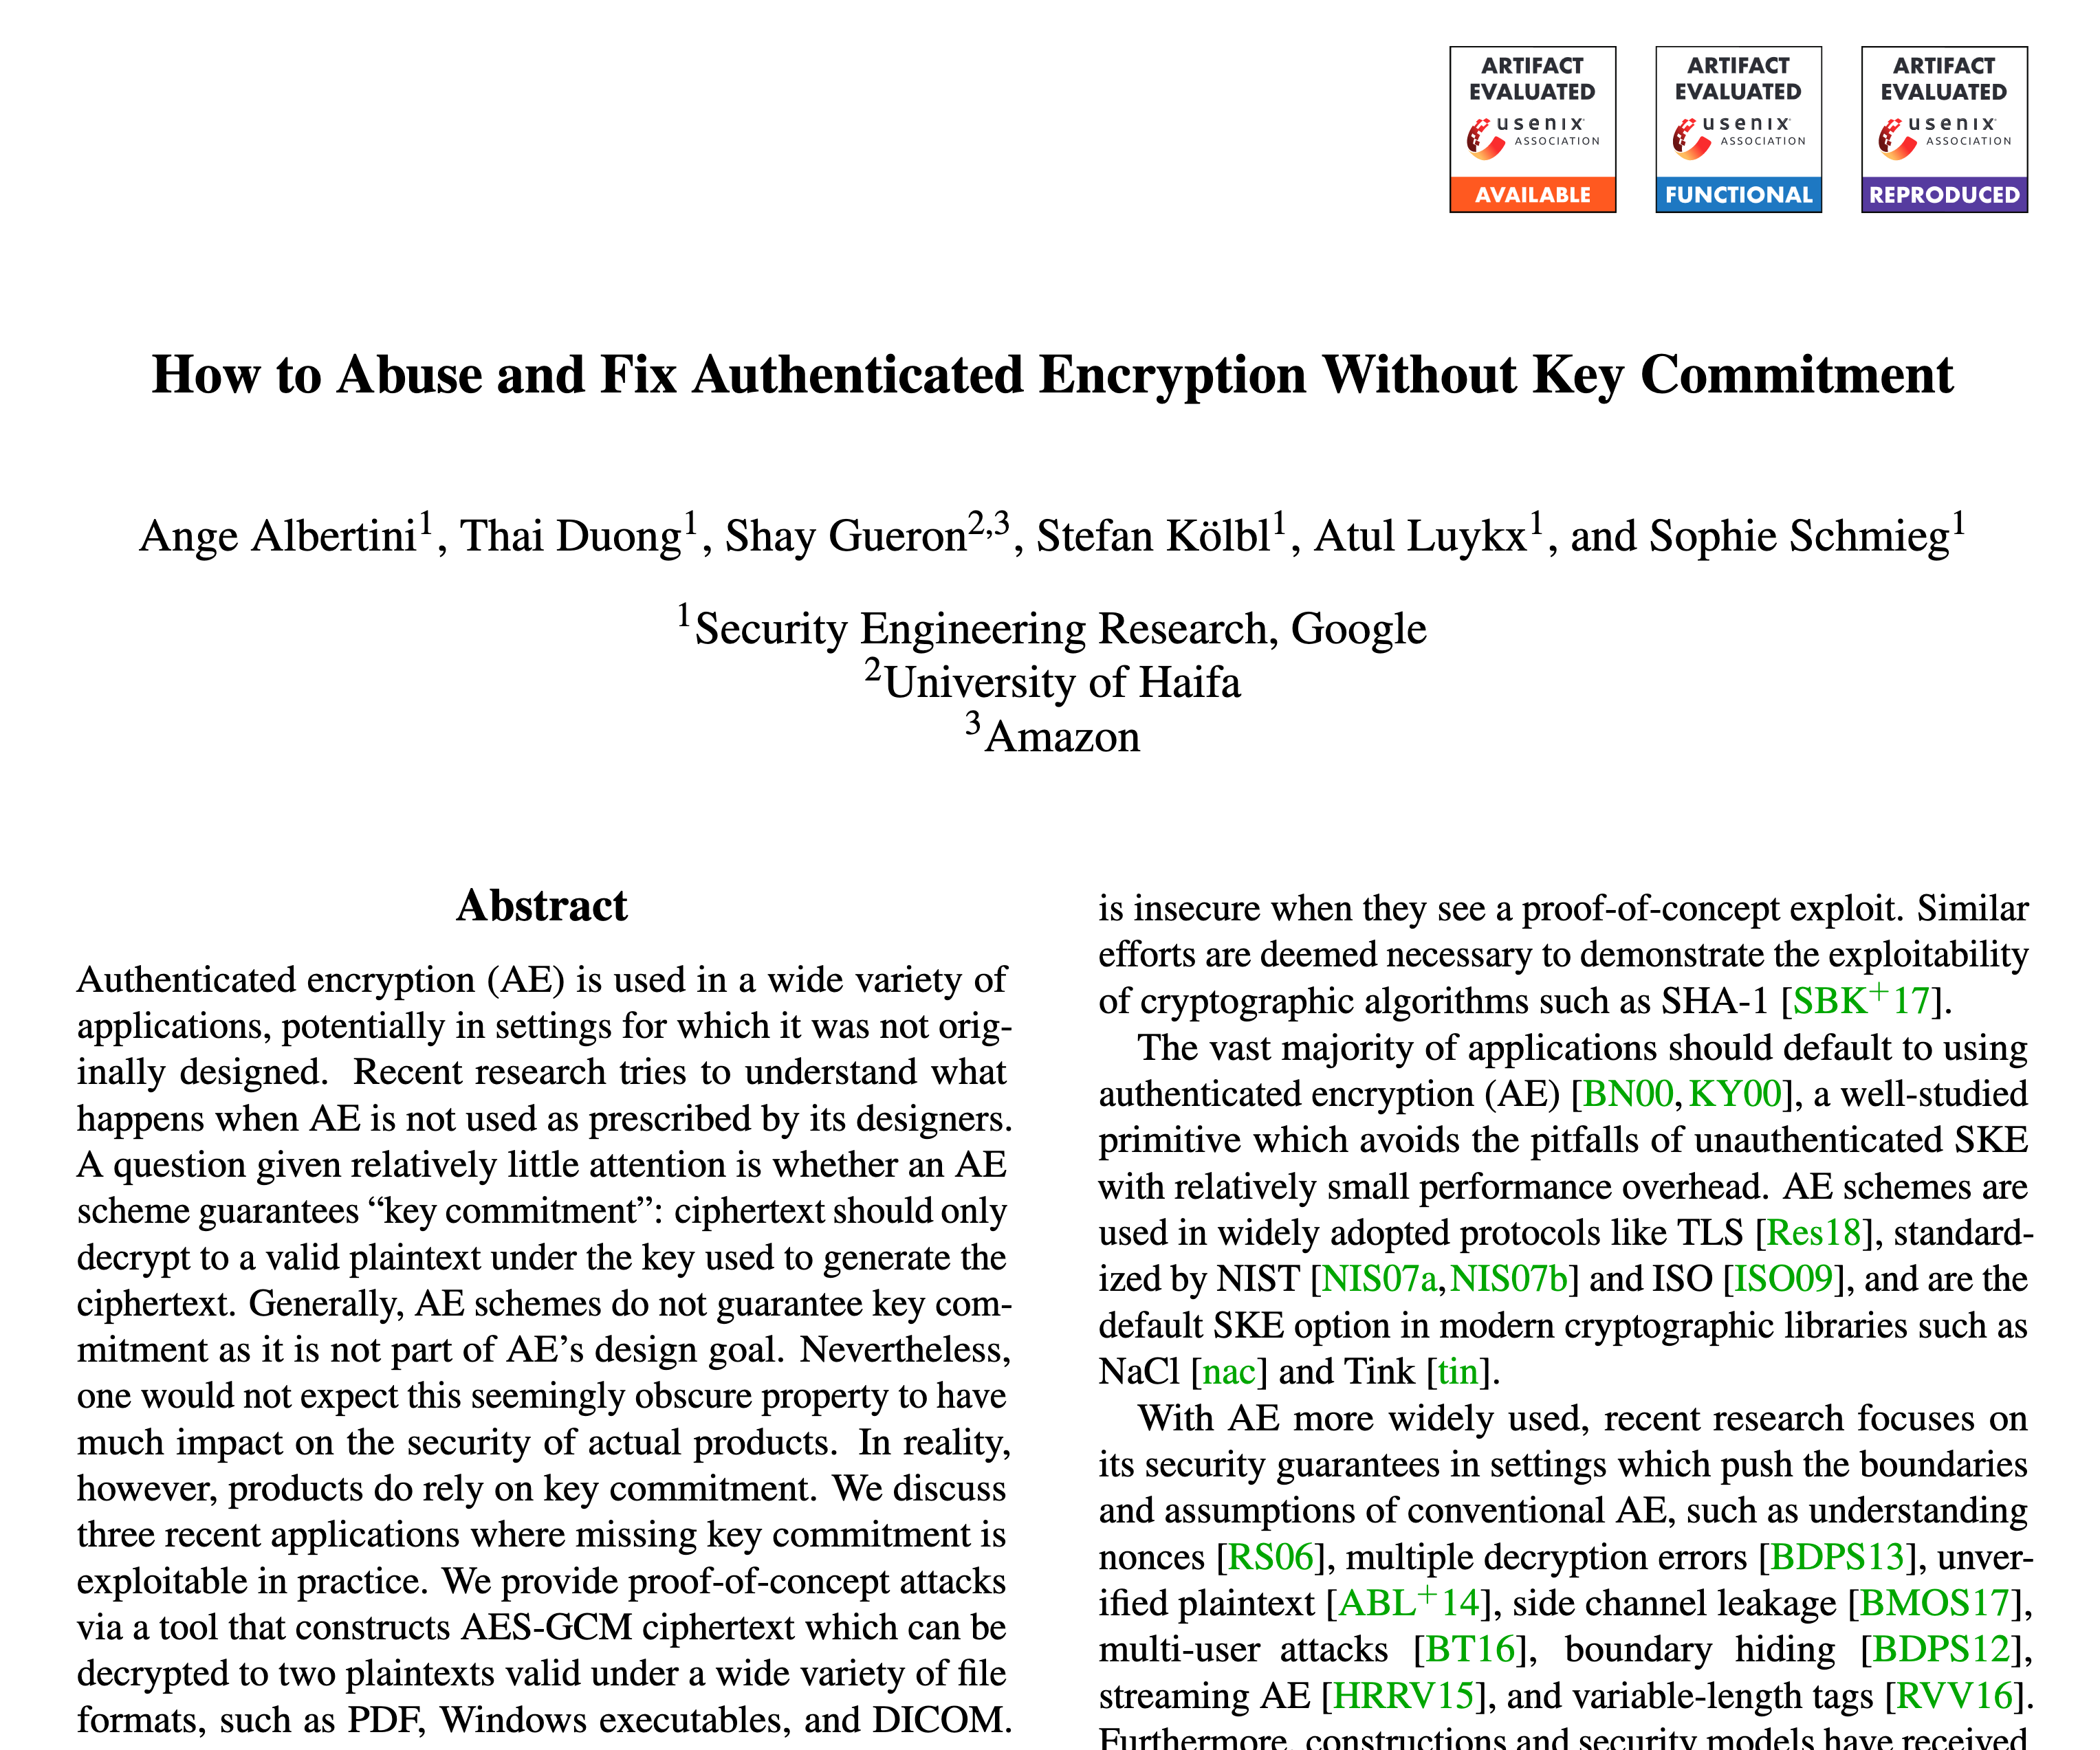
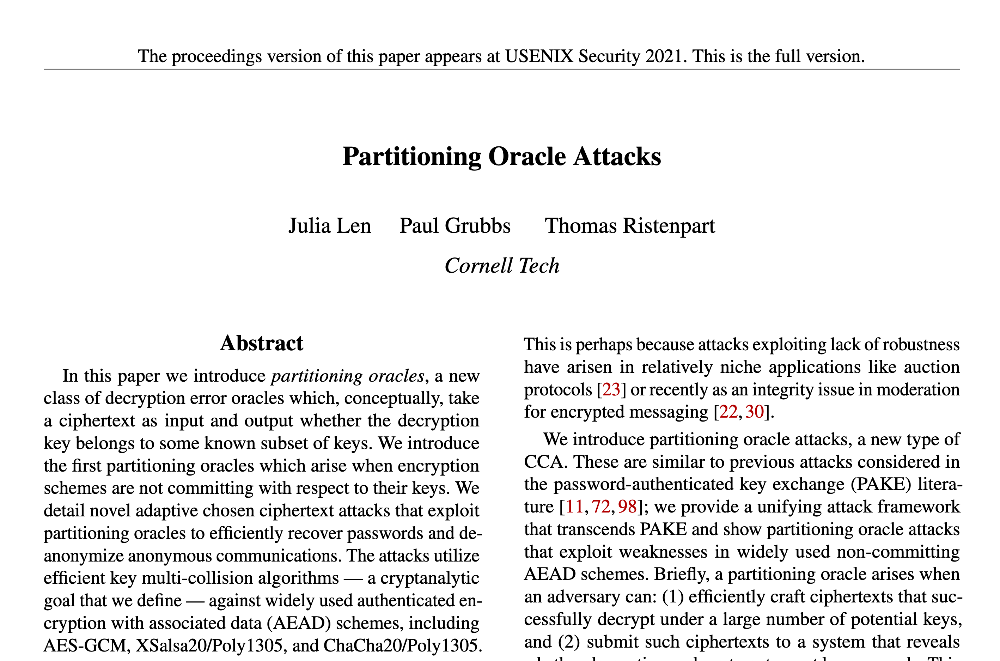
Recent Attacks on AEAD
These attacks work in new threat models!
Notes:
[Show screenshots] But, in recent years, we have a surge of attacks on our use of AEAD.
These attacks target the most widely used schemes like those on the previous slide. This is especially concerning because we have built protocols assuming that AEAD is a solved problem.
What’s going on under the hood is that these attacks highlight new threat models that deviate from the traditional model of a meddler-in-the-middle.

Slide 4




Threat #1: Multi-Recipient Integrity [FOR17, GLR17]
K
Recipient A
N,A,C
N,A,C
Distributor expects same plaintext received
N,A,C
Sender
Ciphertext Distributor
K
Recipient B
Smile indicates intended behavior.
Notes:
To understand these attacks, we need to consider a different architecture that is popular in modern deployments of AEAD.
Here, the sender shares the ciphertext with a ciphertext distributor like a content delivery network, which in-turn sends it to the recipients.
Then, the sender separately shares the privacy-sensitive key with recipients over some other secure channel.
The distributor and the recipients implicitly assume that since they all receive the same ciphertext they will all receive the same plaintext. We call this expectation multi-recipient integrity.
This is the intended behavior. [show smile face]
This works if the sender is honest.

Slide 5


Threat #1: Multi-Recipient Integrity [FOR17, GLR17]
K₁
Red text indicates attacker controlled.
Recipient A
N,A,C
N,A,C
Distributor expects same plaintext received
N,A,C
Malicious Sender
Ciphertext Distributor
K₂
Recipient B
Sobbing indicates unintended behavior.
But malicious sender can arrange for different plaintexts to be received!
Notes:
But if the sender is malicious and we are using a standard AEAD scheme like AES-GCM, then the malicious sender can arrange for different plaintexts to be received.
The malicious sender does this by crafting a specific ciphertext, nonce, and associated data and picking two different keys such that the received plaintexts are different. In this example, recipient A gets an image of a cat while recipient B gets an image of a dog.
This is untended behavior. [Show sobbing face.]

Slide 6
In-use AEAD schemes are not key committing [FOR17, GLR17]
For AEAD = XXX computationally efficient to find
K₁ ≠ K₂ and N, A, C
such that decryption
M₁ = AEAD.Dec(K₁,N,A,C)
M₂ = AEAD.Dec(K₂,N,A,C)
succeeds and M₁ ≠ M₂
XXX | Attack Citation
AES-GCM | [GLR17]
ChaCha20/Poly1305 | [LGR20]
AES-GCM-SIV | [Sch20, LGR20]
AES-OCB3 | [ADGKLS20]
AES-SIV | [MLGR23]
XSalsa20/Poly1305 | [LGR20]
Attacks are fast and
practically damaging
Notes:
And stems from the fact that deployed schemes are not what is called key committing.
Specifically, we say that a scheme is not key committing if it is computationally efficient to find two keys and a ciphertext such that the ciphertext decrypts correctly under both keys and produces different plaintexts.
Most schemes we use in-practice today are not key committing, and modern protocols like TLS 1.3 and WireGuard only support non-key committing ciphers.
Furthermore, finding these colliding ciphertexts and keys takes only a few seconds on a laptop.

Slide 7


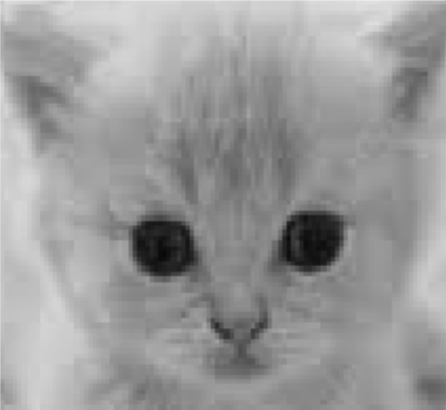


Threat #1: Invisible Salamanders Attack [DGRW19]
K₁
Recipient
Abusive Image
C,N,A
C,N,A
Report
C,N,A
Malicious Sender
Facebook
K₂
Moderator
Benign Image
Multi-recipient integrity vulnerabilities also found in
AWS Encryption SDK
pre-release product reviewed at Google
[ADGKLS20]
Notes:
To see how this affects real-world deployments, let us look at a simplified version of DGRW's attack on Facebook Messenger Abuse Reporting.
Here, a malicious sender chooses a specific ciphertext and sends it to Facebook, which then forwards it to the intended recipient. Then the sender sends a specifically crafted key to the intended recipient under which the ciphertext decrypts to an abusive message.
The intended recipient then reports this message to the moderator, who gets a copy of the ciphertext from Facebook.
Now the malicious sender sends a different key to the moderator under which the ciphertext decrypts to a benign image.
This clearly breaks abuse reporting.
Similar multi-recipient integrity vulnerabilities have been found and patched in the AWS Encryption SDK and in a pre-release product at Google.

Slide 8

Threat #2: Partitioning oracle attacks [LGR20]
Server uses password to decrypt ciphertexts
Malicious client wants to guess the password by sending ciphertexts
password
C₁
⊥ ≠ AEAD.Dec(KDF(password),C₁)
Malicious Client
C₂
Server
⊥ ≠ AEAD.Dec(KDF(password),C₂)
…
Security expected: one ciphertext = one guess
Previous slide: one ciphertext = two guesses
[LGR20]: one ciphertext = up to 4096 guesses (for AES-GCM)
Notes:
And that's not it, after those attacks, a new class of attacks was discovered which targeted confidentiality rather than integrity.
These so-called partitioning oracle attacks arise in setting where for example the server knows a password and reveals to a client whether that password successfully decrypts a submitted ciphertext.
In this setting, then the malicious sender can attempt to recover the password by sending a ciphertext encrypted under a guessed password.
Ideally, one submitting ciphertext should allow ruling out one guessed password. But we just saw that we can construct ciphertexts that decrypt under two keys. So, this would allow ruling out two passwords per ciphertext.
LGR showed how to construct, in 30 seconds, ciphertexts for AES-GCM that decrypt under 4096 given keys. So, this would allow ruling out 4096 passwords per ciphertext.

Slide 9
Threat #2: Partitioning oracle attacks [LGR20]
C₁
password
⊥ ≠ AEAD.Dec(KDF(password),C₁)
~6x increase in password recovery
C₂
⊥ ≠ AEAD.Dec(KDF(password),C₂)
Malicious Client
C₃
Shadowsocks Server
⊥ ≠ AEAD.Dec(KDF(password),C₃)
Partitioning oracle vulnerabilities also found in
early, non-compliant OPAQUE implementations
other open-source libraries
Notes:
The Shadowsocks UDP proxy was vulnerable to this type of attack.
LGR showed that using ciphertexts that decrypt under thousands of keys, one can significantly improve the odds of recovering the password compared to the traditional bruteforce approach which tries one password at a time, for a fixed number of submissions to the server.
A similar attack was also possible on early, non-compliant implementations of OPAQUE.
And several other open-source libraries were potentially vulnerable to this attack.

Slide 10
Summary of Vulnerabilities
Application | Attack | Impact | Citation
Facebook Messenger abuse reporting | Multi-recipient integrity | Makes it impossible to report specifically crafted images. | [GLR17] [DGRW19]
AWS Encryption SDK multi-recipient sending | Multi-recipient integrity | Can send different messages to different recipients. | [ADGKLS20]
… | … | … | …
Shadowsocks UDP | Partitioning oracle | Faster password guessing | [LGR20]
Non-compliant OPAQUE implementations | Partitioning oracle | Faster password guessing | [LGR20]
… | … | … | …
[GLR17] Paul Grubbs, Jiahui Lu, and Thomas Ristenpart. Message franking via committing authenticated encryption. ia.cr/2017/664
[LGR20] Julia Len, Paul Grubbs, and Thomas Ristenpart. Partitioning Oracle Attacks. ia.cr/2020/1491
[DGRW19] Yevgeniy Dodis, Paul Grubbs, Thomas Ristenpart, and Joanne Woodage. Fast message franking: From invisible salamanders to encryptment. ia.cr/2019/016
[ADGKLS20] Ange Albertini, Thai Duong, Shay Gueron, Stefan Kölbl, Atul Luykx, and Sophie Schmieg. How to Abuse and Fix Authenticated Encryption Without Key Commitment. ia.cr/2020/1456
Notes:
To summarize, we have seen two kinds of attacks on authenticated encryption schemes. The first class, multi-recipient integrity attacks, violate integrity in multi-recipient settings. The second class, partitioning oracle attacks, violate confidentiality in password-based settings. We discussed two examples for each but there are many more instances of these attacks, see the papers listed on the screen.

Slide 11
Attacks break the most widely used AEAD schemes
They do not invalidate prior security analyses …
… they exploit lack of key commitment
Notes:
To put it simply, these attack break the most widely used AEAD schemes.
They do not invalidate prior security analyses.
They exploit the lack of key commitment.

Slide 12
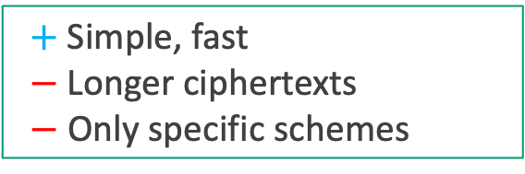
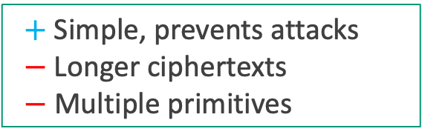
Some Proposals for Key Commitment [ADGKLS20]
Key hashing [ADGKLS20]:
Append CR hash H(K)
to ciphertext
C = AEAD.Enc(K,N,A,M)
Output H(K) ‖ C
$+$Simple, prevents attacks
$−$Longer ciphertexts
$−$ Multiple primitives
Padding zeros [ADGKLS20]:
Add plaintext redundancy, check on decrypt
C = AEAD.Enc(K,N,A, 0^{2λ} ‖ M)
Output C
$+$Simple, fast
$−$Longer ciphertexts
$−$ Only specific schemes
We could standardize these or other key-committing solutions
Notes:
So, how do we achieve key commitment.
A traditional folklore approach is to append a hash of the key to the ciphertext. A variant of this is currently deployed by the AWS Encryption SDK. This approach clearly works but extends the length of the ciphertext by another two lambda where lambda is the security parameter and might require multiple primitives. In the case of the AWS Encryption SDK, you encrypt with AES-GCM and hash the key with HKDF-SHA-512 which requires two primitives.
A more lightweight approach is to append 2 lambda zeroes to the message and encrypt that. And during decryption ensure that the zeros are unchanged. This serves as a makeshift hash of the key since changing the key would change the zeros. This approach was suggested in a previous draft of OPAQUE. While this approach does not require any additional primitives, it also extends the length of a ciphertext by another two lambda bits.
These approaches exist, are fast, provably secure, and deployed in practice, and we _could_ standardize one of them…

Slide 13
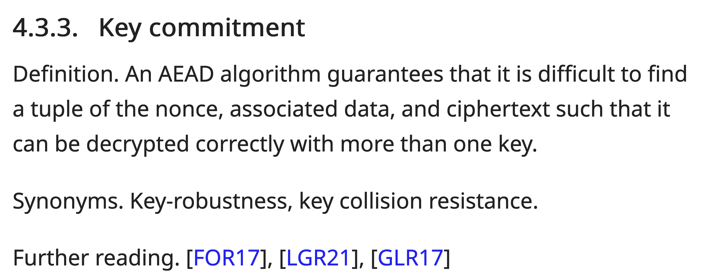
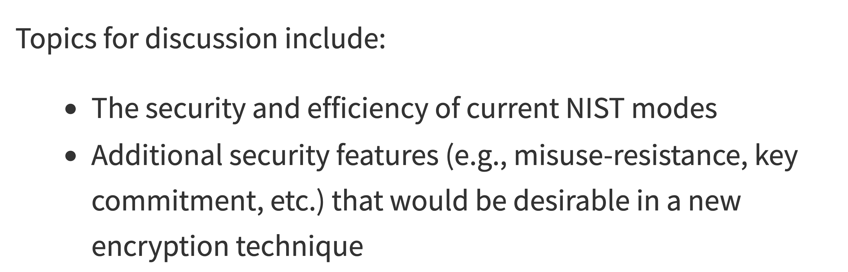
We could standardize a key-committing solution
But we fear this is short-sighted
draft-irtf-cfrg-aead-properties-01
https://datatracker.ietf.org/doc/draft-irtf-cfrg-aead-properties/01/
The Third NIST Workshop on Block Cipher Modes of Operation
https://csrc.nist.gov/Events/2023/third-workshop-on-block-cipher-modes-of-operation
Notes:
And indeed, there are current efforts to standardize key committing AEAD schemes.
A recent CFRG drafts calls out key commitment as a desirable attribute for AEAD schemes.
And an upcoming NIST workshop on block cipher modes of operation similarly calls out key commitment.
So, we _could_ just standardize one of the key committing approaches on the previous slide or some other key committing approach…
But we fear that this is short-sighted.

Slide 14

Revisiting Multi-Recipient Integrity [BT22,CR22,MLGR23]
K₁
Recipient A
N,A,C
N,A,C
Distributor expects same plaintext received
N,A,C
Malicious Sender
Ciphertext Distributor
K₂
Recipient B
If K₁ = K₂, both get same plaintext
If K₁ ≠ K₂, and key commitment, one gets error
Notes:
To understand why, let's go back to the multi-recipient integrity setting.
Recall that if the keys are the same, then the recipients get the same plaintext, and this is true even for an adversarial choice of ciphertext, nonce, and associated data.
Further, if we use a key committing scheme and the malicious sender picks two different keys, then at least one of the recipients gets an error.
This is exactly what we want.
But if we change this setting just slightly, sending one or both the nonce and associated data separately to the recipients, …

Slide 15
Revisiting Multi-Recipient Integrity [BT22,CR22,MLGR23]
K,N₁,A₁
Recipient A
C
C
Distributor expects same plaintext received
C
Malicious Sender
Ciphertext Distributor
K,N₂,A₂
Recipient B
If keys are same but N and A differ,
even with key commitment, get different plaintexts
Notes:
Then problems re-emerge. In particular, the attacker can use the same key but instead vary the nonce or associate data to re-enable violations of multi-recipient integrity.
This works because key commitment only ensures that the keys are the same, and what we really want is instead what we call…

Slide 16
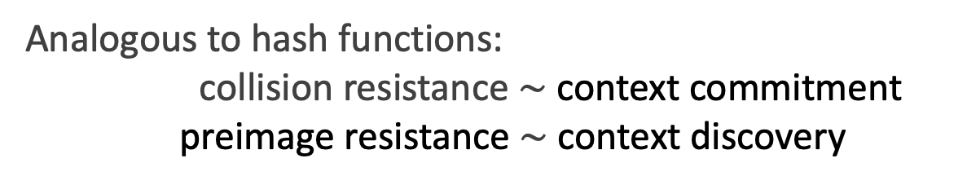
In-use AEAD schemes are not context committing
For AEAD = XXX computationally efficient to find
such that decryption
succeeds
(K₁, N₁ , A₁) ≠ (K₂, N₂, A₂) and C
Context
committing
Key
committing
M₁ = AEAD.Dec(K₁ N₁,A₁,C)
M₂ = AEAD.Dec(K₂,N₂,A₂,C)
Large space of definitions [BT22, CR22, MLGR23]
Analogous to hash functions:
collision resistance $\sim$ context commitment
preimage resistance $\sim$ context discovery
Notes:
Context commitment. This is a notion that we recently introduced to capture this more general notion of commitment.
Specifically, we say that a scheme is not context committing if it is computationally efficient to find two contexts (key, nonce, and associated data triples) and a ciphertext such that the ciphertext decrypts correctly under both contexts. Context commitment is a strictly stronger security property than key commitment.
More broadly, our recent works introduce a large space of new definitions, which are in some ways analogous to hash function security notions such as collision-resistance. For example, at Eurocrypt later this year we will describe a new AEAD security goal called context discovery security, which is like preimage resistance.
That said, these other notions are implied by a scheme being context committing, so for the purposes of this talk we’ll focus on just achieving context commitment.

Slide 17
In-use AEAD schemes are not context committing
For AEAD = XXX computationally efficient to find
such that decryption
succeeds
XXX | Key Committing Attack? | Context Committing Attack?
AES-GCM | [GLR17]
ChaCha20 /Poly1305 | [LGR20]
AES-GCM-SIV | [Sch20, LGR20]
AES-OCB3 | [ADGKLS20]
AES-SIV | [MLGR23]
XSalsa20 /Poly1305 | [LGR20]
(K₁, N₁ , A₁) ≠ (K₂, N₂, A₂) and C
M₁ = AEAD.Dec(K₁ N₁,A₁,C)
M₂ = AEAD.Dec(K₂,N₂,A₂,C)
Notes:
Unfortunately, not only do non-key-committing schemes not achieve context commitment, but …

Slide 18
In-use AEAD schemes are not context committing
For AEAD = XXX computationally efficient to find
such that decryption
succeeds
XXX | Key Committing Attack? | Context Committing Attack?
AES-GCM | [GLR17] | [GLR17]
ChaCha20 /Poly1305 | [LGR20] | [LGR20]
AES-GCM-SIV | [Sch20, LGR20] | [Sch20, LGR20]
AES-OCB3 | [ADGKLS20] | [ADGKLS20]
AES-SIV | [MLGR23] | [MLGR23]
XSalsa20 /Poly1305 | [LGR20] | [LGR20]
(K₁, N₁ , A₁) ≠ (K₂, N₂, A₂) and C
M₁ = AEAD.Dec(K₁ N₁,A₁,C)
M₂ = AEAD.Dec(K₂,N₂,A₂,C)

Slide 19
In-use AEAD schemes are not context committing
For AEAD = XXX computationally efficient to find
such that decryption
succeeds
XXX | Key Committing Attack? | Context Committing Attack?
AES-GCM | [GLR17] | [GLR17]
ChaCha20 /Poly1305 | [LGR20] | [LGR20]
AES-GCM-SIV | [Sch20, LGR20] | [Sch20, LGR20]
AES-OCB3 | [ADGKLS20] | [ADGKLS20]
AES-SIV | [MLGR23] | [MLGR23]
XSalsa20 /Poly1305 | [LGR20] | [LGR20]
Padding Zeros |  | [BH22]
Key hashing |  | [MGLR23]
(K₁, N₁ , A₁) ≠ (K₂, N₂, A₂) and C
M₁ = AEAD.Dec(K₁ N₁,A₁,C)
M₂ = AEAD.Dec(K₂,N₂,A₂,C)
Key commitment countermeasures
don’t ensure context commitment
Notes:
even our key commitment countermeasures do not ensure context commitment.
These attacks are, however, against the schemes and not against deployed systems. And we don’t yet know of any real-world vulnerabilities that arise from just lack of context commitment.
This puts us in a delicate position as we consider standardizing committing schemes. If we consider the timeline here

Slide 20
Committing Encryption Timeline
Partitioning oracle attack
and
Key commitment countermeasures
[LGR20, ADGKLS20]
Key commitment theory
[FOR17, GLR17]
Invisible salamanders attack
[DGRW19]
Context commitment theory
[BH22,CR22,MLGR23]
???
2017
2019
2020
2022
Future
Notes:
We had, six years ago, already some work on the theory of key commitment for AEAD.
Then in 2019, we had the invisible salamanders attack on Facebook Messenger. Then three years ago we had the partitioning oracle attack and the formal analysis of key commitment countermeasures.
Last year and this year, we began developing the theory of context commitment, and so if history repeats itself we expect practically-relevant attacks to appear in the next few years.
The point being that we should really target context commitment now, as we consider standardizing new schemes.

Slide 21
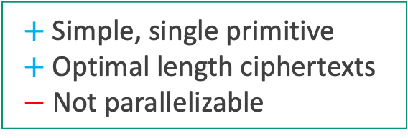
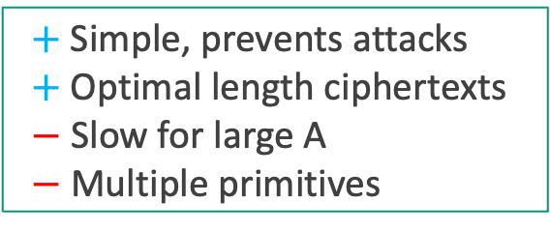
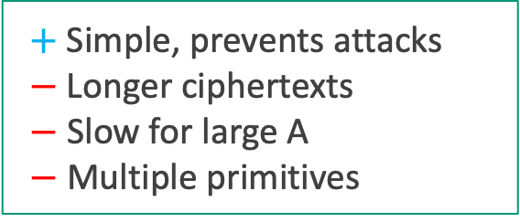
Some Proposals for Context Commitment
Context hashing:
Append CR hash H(K,N,A)
to ciphertext
$+$Simple, prevents attacks
$−$Longer ciphertexts
$−$ Slow for large A
$−$ Multiple primitives
C = AEAD.Enc(K,N,A,M)
Output H(K,N,A) ‖ C
CTX construction [CR22]:
Append CR hash of context and tag (saves space)
C,T = AEAD.Enc(K,N,A, M)
Output H(K,N,A,T) ‖ C
$+$Simple, prevents attacks
$+$Optimal length ciphertexts
$−$ Slow for large A
$−$ Multiple primitives
Hash-based constructions
[BDPA11, DGRW19]:
Duplex-style that use a single pass of hash function
Init(K)
Absorb(N,A)
C = Encrypt(M)
Output Squeeze() ‖ C
$+$Simple, single primitive
$+$Optimal length ciphertexts
$−$ Not parallelizable
Notes:
Fortunately, there are ways to achieve context commitment relatively cheaply.
The most straightforward approach is to append a hash of the context to the ciphertext. This works but extends the length of the ciphertext by two lambda, is slow for large associated data, and might require multiple primitives.
A cleverer construction is to replace the tag with a hash of the context and the tag. This produces optimal length ciphertexts but is still slow for large associated data and might require multiple primitives.
A wholly different approach is to do a hash-based construction like a duplex which natively produces a collision resistant tag that commits to the context. This approach uses a single primitive, has optimal length ciphertexts, but is not parallelizable.
So these are all pretty good, but none of are single primitive, optimal length, *and* parallelizable. Attributes we have been accustomed to by the likes of GCM.

Slide 22


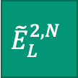
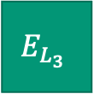
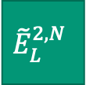
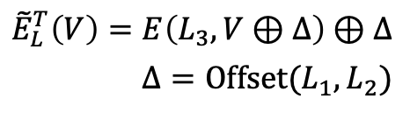

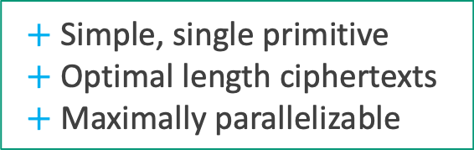
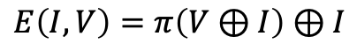

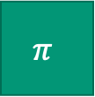

OCH: Fast, Parallelizable Context Committing AEAD [BHLMR23]
V
V
Wide permutation like Keccak or Ascon.
N
M₁
M₂
Checksum
I
$$Δ$$
$$π$$
$$E_{L_{3}}$$
$${\tilde{E}}_{L}^{1}$$
$${\tilde{E}}_{L}^{1,N}$$
$${\tilde{E}}_{L}^{2,N}$$
$${\tilde{E}}_{L}^{2,N}$$
I
$$Δ$$
C₀
C₁
C₂
$$Tag_{L}$$
V
V
T
$$E\left(I,V\right)=π\left(V⊕I\right)⊕I$$
$${\tilde{E}}_{L}^{T}\left(V\right)=E\left(L_{3}, V⊕Δ\right)⊕Δ$$
$$Δ=Offset(L_{1},L_{2})$$
Even-Mansour block cipher [EM97]
OCB inspired authenticated encryption [RBB03]
XE/XEX inspired tweakable block cipher [R04]
HN4 inspired nonce-hiding [BNT19]
$+$Simple, single primitive
$+$Optimal length ciphertexts
$+$ Maximally parallelizable
Notes:
So, we have been working on a construction that seeks to provide all these attributes, and more.
We start from a wide permutation like Keccak or Ascon and build a block cipher using Even-Mansour.
Then, we turn that block cipher into a tweakable block cipher using XEX.
Then have an OCB inspired authenticated encryption mode.
Finally, we also integrate other useful attributes like nonce-hiding.
In sum, this is single primitive construction, with optimal length ciphertext and is maximally parallelizable.
Keep an eye out for our paper, we are hoping to have it on out on ePrint soon.

Slide 23
Is context committing AEAD right for you?
Yes
Future-proof against potential context commitment attacks.
Minimal performance overhead over a key committing scheme.
Notes:
With all this background we are ready to answer the question in the title. Is context committing AEAD right for you? We say yes, because
While we don’t have practical attacks that exploit the lack of context commitment, we are worried that we’d be missing an opportunity to protect protocols from future attacks.
The additional cost to achieve context commitment over key commitment is small.

Slide 24
Next Steps
Build context committing AEAD schemes.
Standardize a few canonical context committing AEAD schemes.
Deploy these few canonical context committing AEAD schemes.
See papers for lots more: ia.cr/2022/268 & ia.cr/2022/1260 & preprint.link/ec23
Thank you! 💙
Emoji in figures from Noto Emoji. Thanks to my co-authors and the Cornell Security Seminar for feedback.
Notes:
I would like to conclude with three calls to action: First, build context committing AEAD schemes. Second, standardize a few canonical context committing AEAD schemes. Third, deploy these few canonical context committing AEAD schemes.
In this talk, I have mostly focused on attacks, but context commitment also creates opportunities. For instance, the previous talk mentioned doing zkproofs over ciphertexts, context commitment enables that.
See our papers for lots more.
Thanks so much for sticking around for my talk.
I am happy to take some questions, but please find me around the conference, or at HACS, or on the internet.

Slide 25
References
[EM97] | Shimon Even and Yishay Mansour. A construction of a cipher from a single pseudorandom permutation. https://doi.org/10.1007/s001459900025
[RBB03] | Phillip Rogaway, Mihir Bellare, and John Black. OCB: A Block-Cipher Mode of Operation for Efficient Authenticated Encryption. https://www.cs.ucdavis.edu/~rogaway/papers/ocb-full.pdf
[R04] | Phillip Rogaway. Efficient Instantiations of Tweakable Blockciphers and Refinements to Modes OCB and PMAC. https://www.cs.ucdavis.edu/~rogaway/papers/offsets.pdf
[BDPA11] | Guido Bertoni, Joan Daemen, Michaël Peeters, and Gilles Van Assche. Duplexing the sponge: single-pass authenticated encryption and other applications. ia.cr/2011/499
[FOR17] | Pooya Farshim, Claudio Orlandi, and Răzvan Roşie. Security of Symmetric Primitives under Incorrect Usage of Keys. ia.cr/2017/288
[GLR17] | Paul Grubbs, Jiahui Lu, and Thomas Ristenpart. Message franking via committing authenticated encryption. ia.cr/2017/664
[DGRW19] | Yevgeniy Dodis, Paul Grubbs, Thomas Ristenpart, and Joanne Woodage. Fast message franking: From invisible salamanders to encryptment. ia.cr/2019/016

Slide 26
References
[BNT19] | Mihir Bellare, Ruth Ng, and Björn Tackmann. Nonces are Noticed: AEAD Revisited. ia.cr/2019/624
[LGR20] | Julia Len, Paul Grubbs, and Thomas Ristenpart. Partitioning Oracle Attacks. ia.cr/2020/1491
[ADGKLS20] | Ange Albertini, Thai Duong, Shay Gueron, Stefan Kölbl, Atul Luykx, and Sophie Schmieg. How to Abuse and Fix Authenticated Encryption Without Key Commitment. ia.cr/2020/1456
[BH22] | Mihir Bellare and Viet Tung Hoang. Efficient schemes for committing authenticated encryption. ia.cr/2022/268
[CR22] | John Chan and Phillip Rogaway. On committing authenticated-encryption. ia.cr/2022/1260
[MLGR23] | Sanketh Menda, Julia Len, Paul Grubbs, and Thomas Ristenpart. Context Discovery and Commitment Attacks: How to Break CCM, EAX, SIV, and More. preprint.link/ec23
[BHLMR23] | Mihir Bellare, Viet Tung Hoang, Julia Len, Sanketh Menda, Thomas Ristenpart. In preparation.

